Slide 1
#TerritorialAgenda
A future for all places
Territorial Agenda long and continous road to incorporate the territorial dimension in European policies
Kai Böhme
- Spatial Foresight -

Slide 2
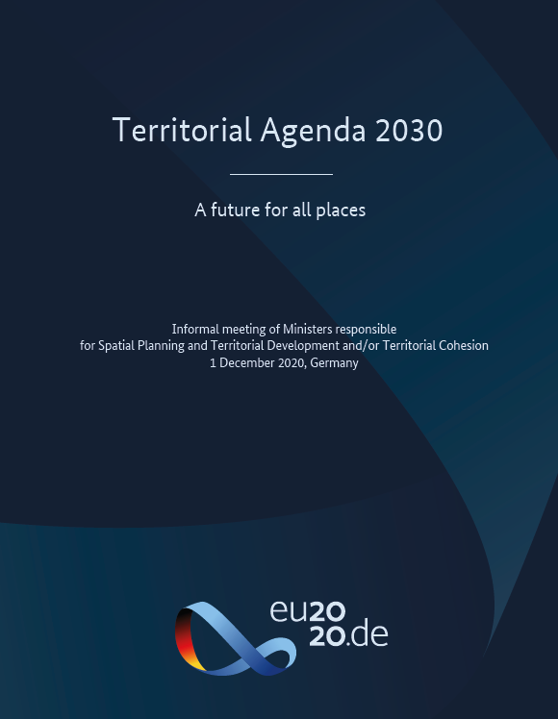
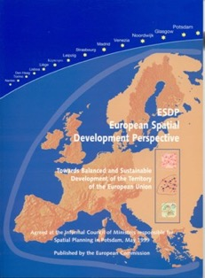
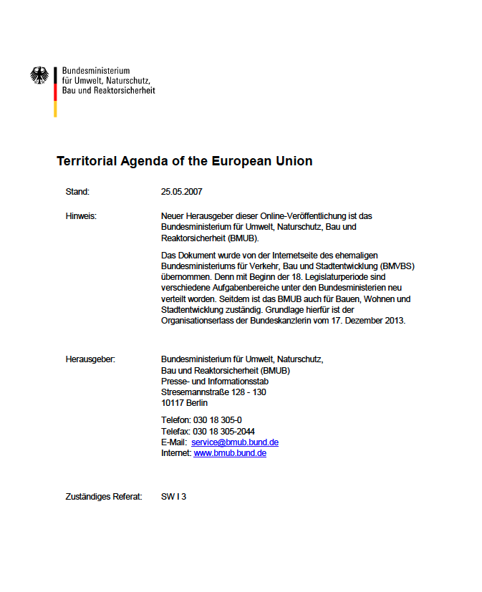
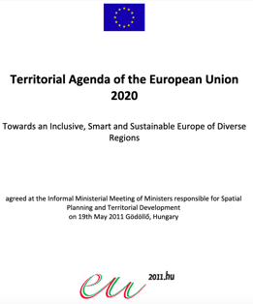

Background
Over 20 years of intergovernmental cooperation
  European Spatial Development Perspective (1999)
  Territorial Agenda of the European Union (2007)
  Territorial Agenda 2020 (2011)

Slide 3

1
Towards a new normal post COVID-19
What has the
Territorial Agenda 2030 to offer?

Slide 4







Today´s challenges
  Climate change and sustainable development
  People and places drift apart
  COVID-19 impacts on local and regional development
What territories, what Europe do we want to have?

Slide 5


Territorial priorities for Europe
A Just Europe
Balanced Europe
Better balanced territorial development utilising Europe’s diversity
Functional Regions
Convergent local and regional development, less inequality between places
that offers future perspectives for all places and people
Integration Beyond Borders
Easier living and working across national borders
A Green Europe
Healthy Environment
Better ecological livelihoods, climate-neutral and resilient towns, cities and regions
Circular Economy
Strong and sustainable local economies in a globalised world
that protects common livelihoods and shapes societal transition
Sustainable Connections
Sustainable digital and physical connectivity of places

Slide 6

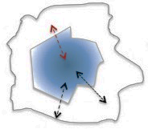
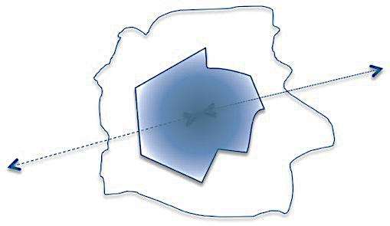
2
Shaping a Just & Green
post COVID-19 Europe
is a shared task for all of us

Slide 7
Putting priorities into action
Intergovernmental cooperation
all players are in charge
  local and regional
  cross-border, transnational, inter- and intra-regional level
  Member State, neighbouring country, EU
Place-based approach
all sectors are in charge
  sector policy impacts – planning, development, transport, environment ...
  multi-level governance
  cooperation between territories
Everyone can take action in the context of her / his regular mandate

Slide 8
What is in it for you?
Strategic territorial focus | Policy integration & synergies | Innovation & experimentation | Governance models & capacities
Strategic, spatial lens identifies specific combinations of challenges and potentials that influence the development of different places. | Cross-cutting issues viewed beyond single sectors, allowing more sophisticated responses. Combines support from different sources. Allows synergetic cooperation and exchange between different territories. | New, experimental approaches are often required in addressing territorial challenges and these are often a source of innovative solutions to complex issues. | Territorial approaches strengthen governance structures and cultures, boosting capacities particularly at the local level.

Slide 9
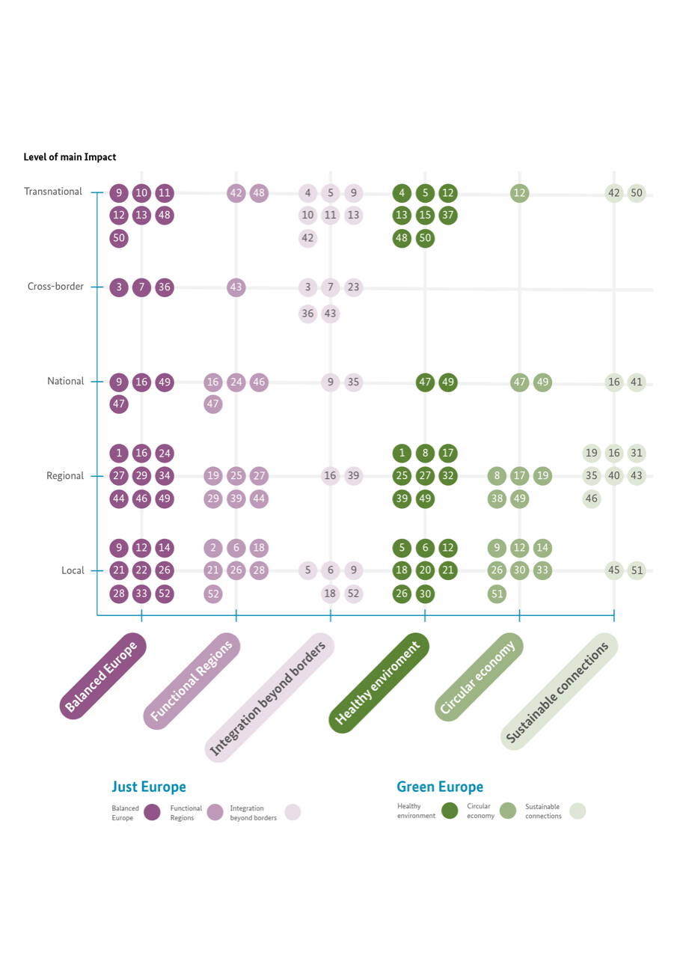
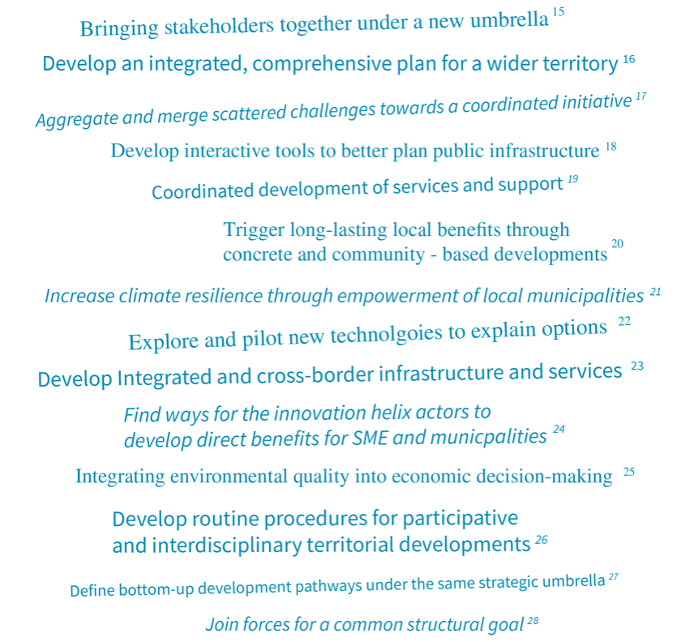
Plenty of examples

Slide 10

Thank you!
Spatial Foresight
Kai Böhme
+352 691 87 32 49 kai.boehme@spatialforesight.eu
www.spatialforesight.eu
@Spatial4sight
@Territothinkers
www.territorialagenda.eu

